Slide 1



Predicting Solar Power Output Using Linear Regression

Slide 2


Learning Objectives
In this project, we are going to learn about how the energy generated by solar panels depends on various environmental factors and the difference between the predicted and actual values of the power generated which will be done with the help of Machine Learning.
GOAL
To use Linear Regression to find the difference between predicted and actual value of power generated.
Source :
www.freepik.com/

Slide 3




Tools and Technology used
Jupyter Notebook
Python
Scikit learn (for machine learning in python)
Excel (for data collection)
Linear Regression model

Slide 4
Methodology
Looking and understanding the datasets with the data collected over time
Cleaning the datasets if necessary, looking for null values to prevent any error
Doing the EDA and visualisation of the data to help finding corelations
Go for the machine learning and train the machine with the help of the data provided
Go for the evaluation of the values to check how much the predicted result by the machine is close to the actual value

Slide 5
Problem Statement:
Solar Power being a renewable and clean source of energy is at a high demand to replace the conventional methods of power generation, but the generation of solar depends on many environmental factors like the height above sea level, amount of sunlight, cloud cover, amount of rainfall, amount of snowfall and many more making the amount of power generated inconsistent and inefficient. So, it is important to find out the place where the solar power can be generated efficiently.
The aim of this project is to find out the amount of energy generated using historical data collected from a particular region and using them to predict the amount of energy that can be generated from the region.

Slide 6
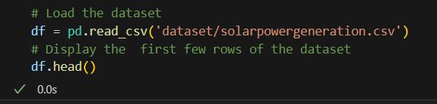




Solution:
Collection of data : A list of 21 historical data has been collected from a region to train the machine learning and test for its accuracy.
Exploratory Data Analysis and Data Cleaning : The data received are checked for any duplicated or null values which can cause problems during the training of the machine.

Slide 7
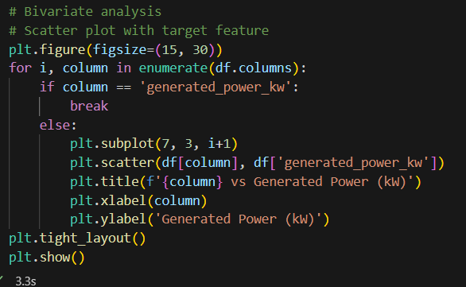
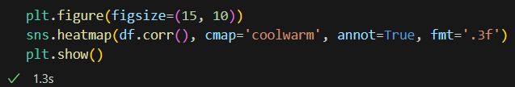
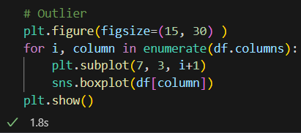
Solution:
Data Visualization : The data collected are represented in a graph to find the most efficient value and the correlation between the historical data collected to produce the output.

Slide 8
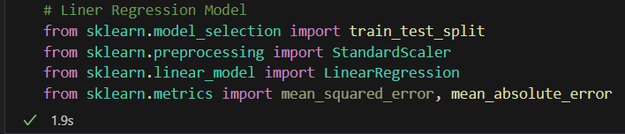

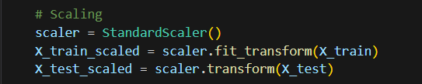

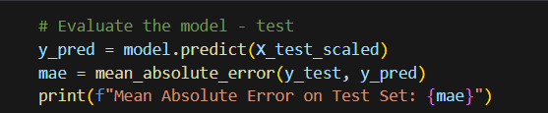
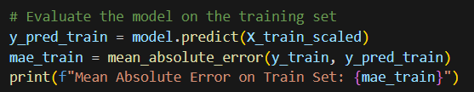
Solution:
Training the Machine : Using the historical data collected and verified, the Machine is trained using Linear Regression to find the predicted amount of energy generated.
Testing : By finding the mean absolute error of the predicted and actual values we can check how good the machine is in predicting

Slide 9
Screenshot of Output:
Output of the predicted mean absolute error by the machine
Output of the actual mean absolute error

Slide 10
Conclusion:
From the mean absolute error of the predicted and real value of generated power, we can conclude that by using Linear Regression, it was a successful training of the machine and it is able to predict close to the actual value which can be used to find out the possible power generated in a particular area with reference to the twenty other factors and data collected in that region and make decisions to find out how much power can be generated from that location.

